Slide 1
UMMC Occupational Therapy Department Virtual Simulation-Module 6
Occupational Therapy & Assistive Technology
4 hours
After reviewing this module, please complete the corresponding section in the
Virtual Observation Reflection packet.

Slide 2
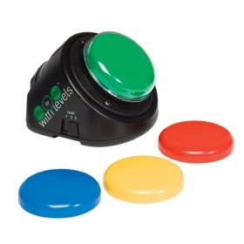
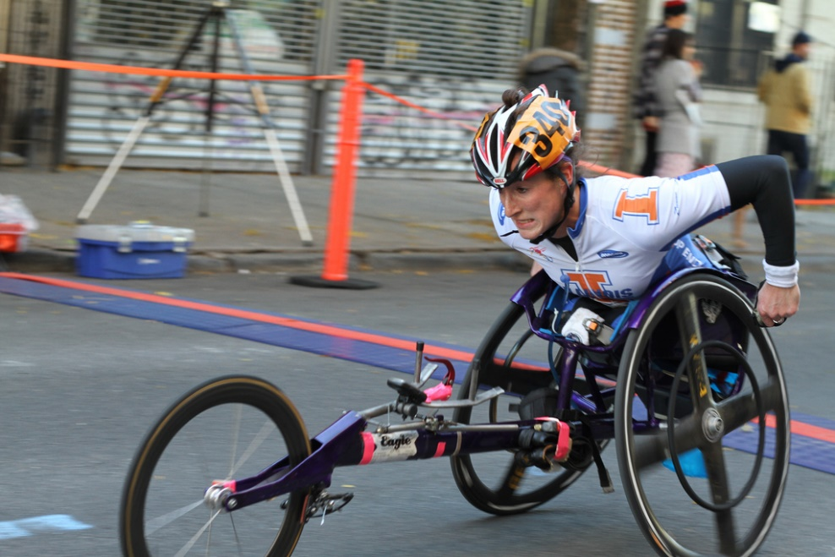
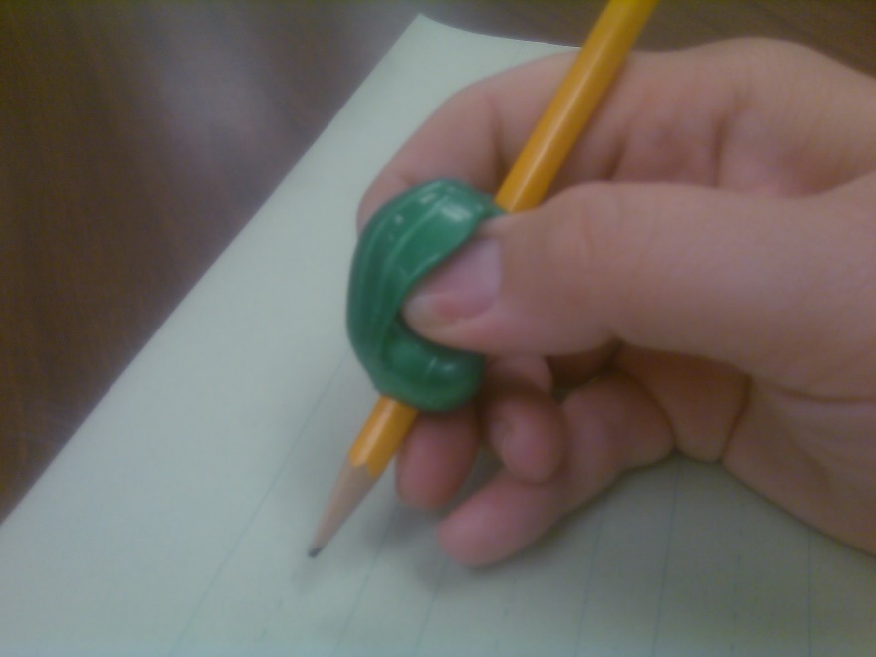
Review
Watch Video Case – Assistive Technology in OT
Read: Providing Assistive Technology Fact Sheet

Slide 3
Assistive Technology
Watch
OT TED Talk: http://www.otcentennial.org/video/accessible-design-occupational-therapist-give-ted-talk
Complete Assignment
Write a two-page (double spaced) review Sheena’s case and the Ted Talk. What do you think about using adaptive equipment? Is this an area of OT that interests you?
Find two apps on your phone, one that could give you medication reminders and one that could be used by someone who has a visual impairment.

Slide 4
References
Cohen, H. (2016, November). Accessible fart machines and hand-less video game controllers [Video]. TED Conferences. Youtube. https://www.youtube.com/watch?time_continue=12&v=-We84cxubCY&feature=emb_title
Larson, B. (2012, June 1). Assistive technology and OT [Video]. YouTube. https://www.youtube.com/watch?v=anhesZIzqFM
Goodrich, B., & Garza, E. (2015) Providing assistive technology devices and services [Fact Sheet]. American Occupational Therapy Association

